Slide 1
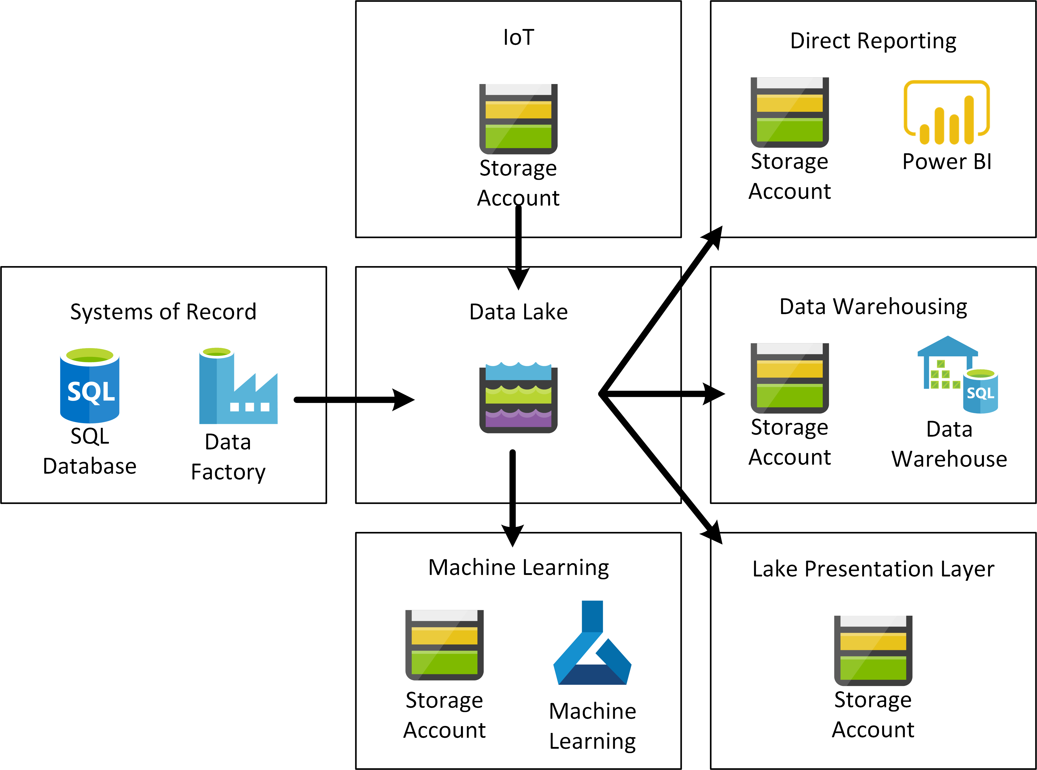
The Data Lake

Slide 2
Primary Roles
Data Providers
Supply the lake with data
Keep that data up to date
Fairly basic users of the lake
Write access via automation
Data Consumers
Use data from the lake
Enrich data on the lake
Advanced users
Write access via automation (to core lake)
Product Managers

Slide 3
Provider Knowledge
Ingest methods
Tumbling window
Batch
API
Stream
Security Model
Lifecycle management
Deployment methods

Slide 4
Consumer Knowledge
Domain specific
Machine Learning/Data Science
Data Warehousing
Big Data Analytics
Security model
Lifecycle Management
Iterative approach
Backlog management

Slide 5
Product Managers
Sit between the business (“customers”) and the data team
Marketing
Show the business what the product can do now
Ensure everyone is aware of the good things being done
Research
Find problems, report back
Find shortfalls in capability, report back
Head up the user community

Slide 6




Provider Example 1 - Batch
Data Lake
Data Factory
Storage Account
CSV Files

Slide 7





Provider Example 2 - Streaming
POS Solution
Stream Analytics
PowerBI
POS
Event Hubs
Storage Account
AVRO Files
Data Lake
Function App
Storage Account
CSV Files

Slide 8


Provider Example 3 – External Data
Data Lake
External API
Logic App
Storage Account
JSON Files

Slide 9

Consumer Example 1 – Data Enrichment
Data Lake
CSV Files
Storage Account
Data Lake Store
Parquet Files
JSON Files
Data Factory

Slide 10


Consumer Example 2 – Data Warehousing
Data Warehouse
Data Lake
Data Factory
Storage Account
CSV Files
Spark
Parquet Data Model
Synapse
Data Models

Slide 11



Consumer Example 3 – Machine Learning
Data Lake Store
Compute
Data Lake
Azure ML
Containers
Storage Account
CSV Files
Container Registry

Slide 12
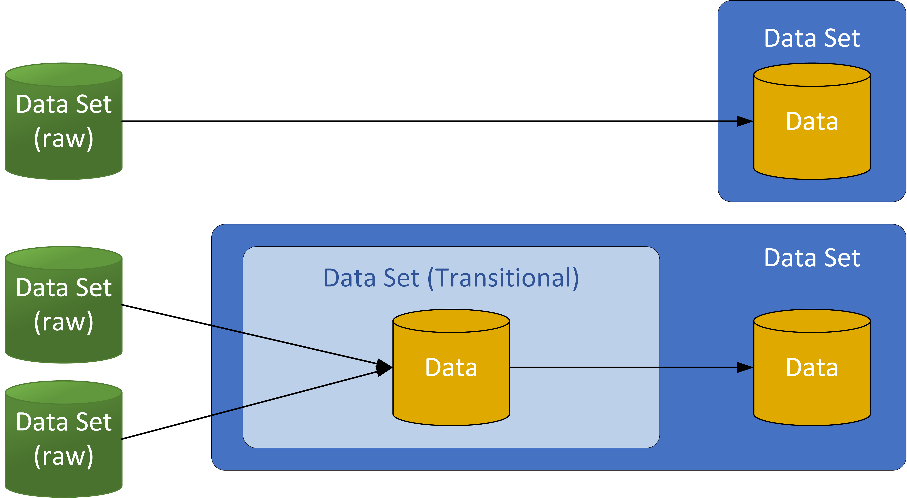
Data Sets (Encapsulation)
Data life cycle management
Regulatory Compliance
Availability Requirements
Transformation of data
Data delivery contract (Schema)
Access control
Performance Requirements
Location/Region
List of Data Consumers

Slide 13
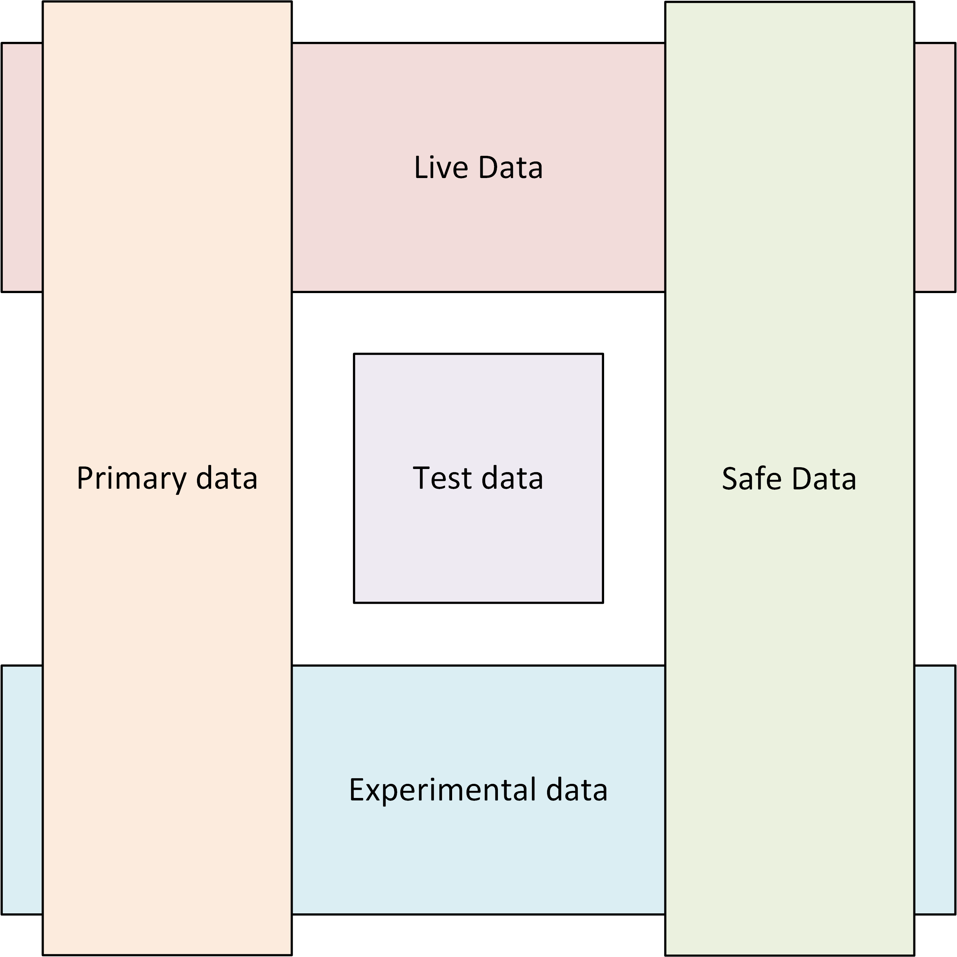
Environmental Classification

Slide 14
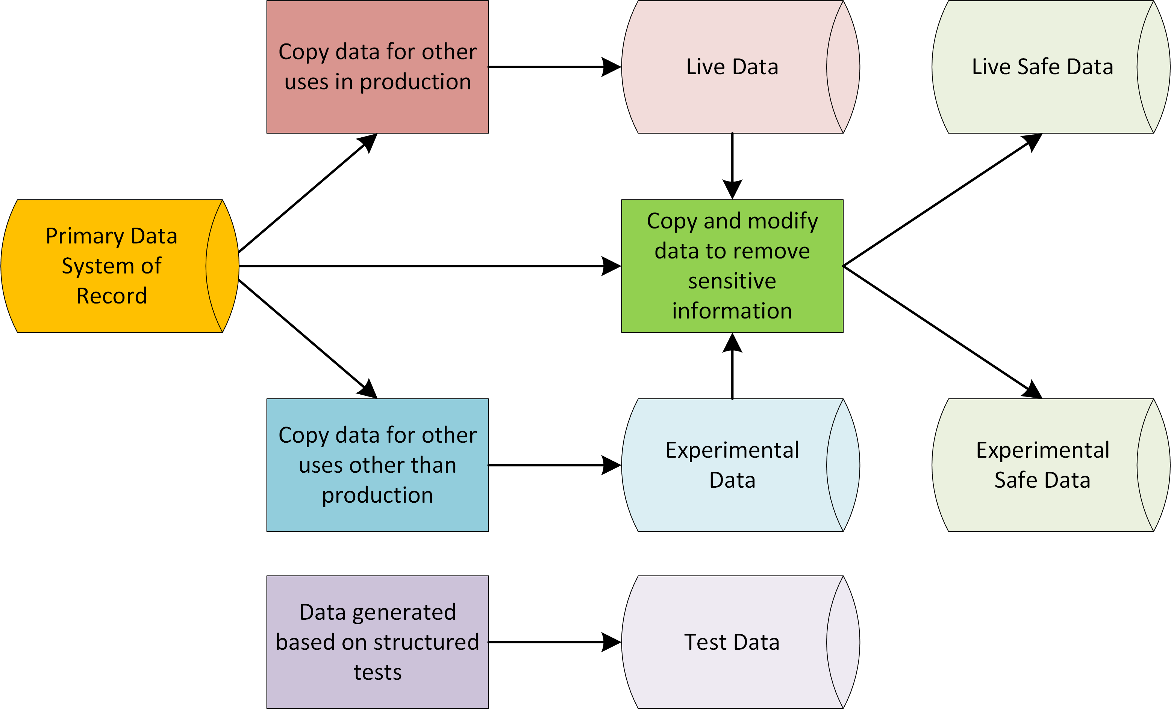
Environmental Classification

Slide 15
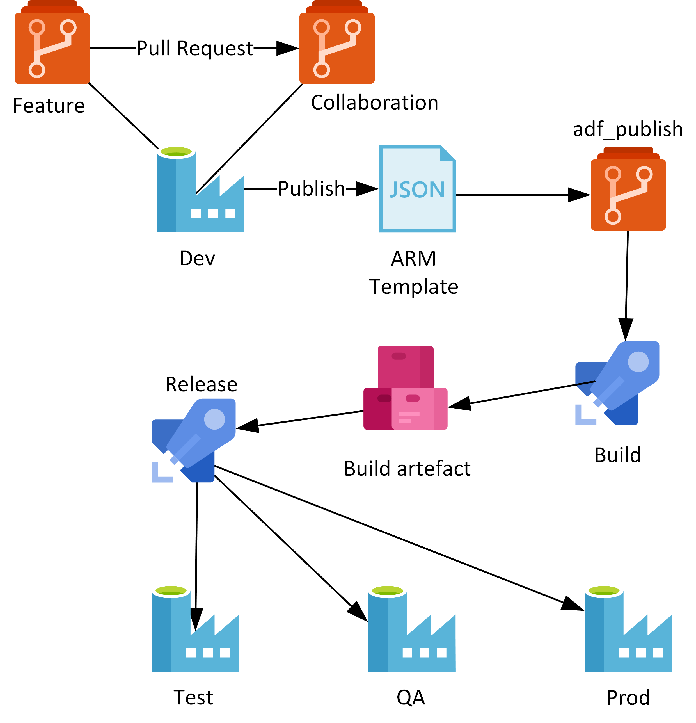
Lifecycle and Code Management

